Slide 1
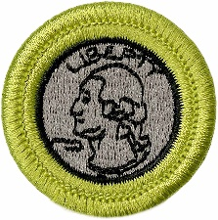
Coin Collecting Merit Badge
Troop 344/9344
Pemberville, OH

Slide 2
Coin Collecting Merit Badge Requirements
Understand how coins are made, and where the active U.S. Mint facilities are located.
Explain these collecting terms:
Obverse
Reverse
Reeding
Clad
Type set
Date set
Describe three different ways to store a collection, and the benefits, drawbacks, and cost of each method.

Slide 3
Coin Collecting Merit Badge Requirements
Do each of the following and explain to your counselor the design features, designer name, designer initials, and where to find them for each item:
Collect a one-cent coin from the year group: 1959-2008 (that is, dated between 1959 and 2008) and a one-cent coin from the year group 2010-present. Explain how and why the one-cent coins issued in 2009 were different from either of the other two year groups.
Collect two five-cent coins, one from each of these year groups: 1959- 2003 and 2006-present. Explain how and why the five-cent coins issued in 2004-2005 were different from either of the other two year groups.
Collect a ten-cent coin from 1965-present.
Collect a twenty-five-cent coin from 1965-1998, two examples from the 50-State Quarter®/territories Program 1999-2009, two designs from the America the Beautiful® program 2012-2021 and two designs from the American Woman Quarter® program (2022-2024). Explain the purpose of each of those programs.
Collect a half dollar coin from 1965-present.
Collect a dollar coin from each of these design groups: Susan B. Anthony 1979-81, Sacagawea 1990-2005, U.S. Presidents 2000-2014.

Slide 4
Coin Collecting Merit Badge Requirements
Describe and discuss with your counselor the special reverse designs of the quarters, half dollar and dollar coin struck in 1975-1976 to honor the U.S. Bicentennial.
Identify for your counselor the people depicted on current currency: $1, $2, $5, $10, $20, $50, and $100 notes. Explain where United States currency is printed.

Slide 5
Coin Collecting Merit Badge Requirements
Do ONE of the following:
Collect and identify for your counselor 20 different world coins from at least 7 different countries. Identify the country, major design elements, and denomination of each.
Collect and identify for your counselor 20 different world paper money from at least 7 different countries. Identify the country, major design elements, and denomination of each.
Collect and identify for your counselor 20 different tokens and/or medals. Identify the issuer and use of each.
Complete one of the following and report to your counselor what you experienced:
Attend a coin show
Attend a coin club meeting
Tour a U.S. Mint facility or museum
Tour a virtual exhibit (with your parent or guardian’s permission) approved by your counselor.

Slide 6
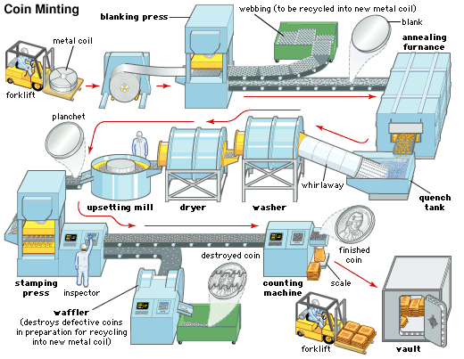
Requirement 1
Understand how coins are made, and where the active U.S. Mint facilities are located.

Slide 7
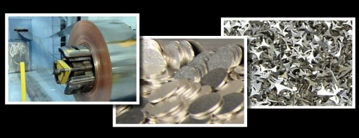
How Coins are Made
Step 1: Blanking
The United States Mint uses rolls of metal that are approximately 13 inches wide and weigh several thousand pounds.
The roll of metal is unwound and flattened to remove the curvature from the manufacturing process.
It is then passed through a machine that punches out discs of metal that are now the proper thickness and diameter for the coin being made.

Slide 8
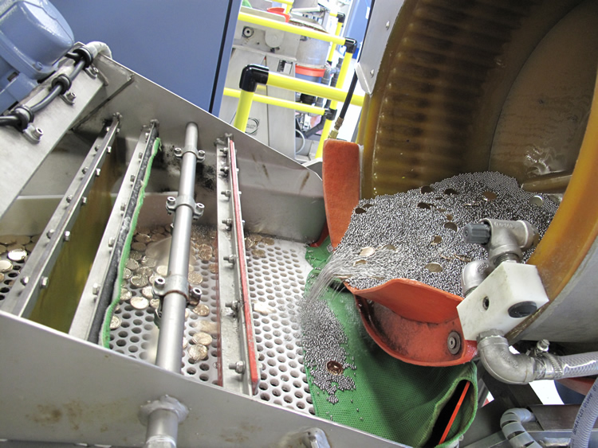
How Coins are Made
Step 2: Riddling
Up to this point, the production process used to fabricate the metal blanks is dirty and is ran in a harsh environment.
It is possible for small pieces of waste metal to get mixed in with the coin blanks.
The riddling machine are mechanical sifters that cull out undersize, oversize and misshapen blanks and from any foreign matter mixed in with the coin blanks.

Slide 9
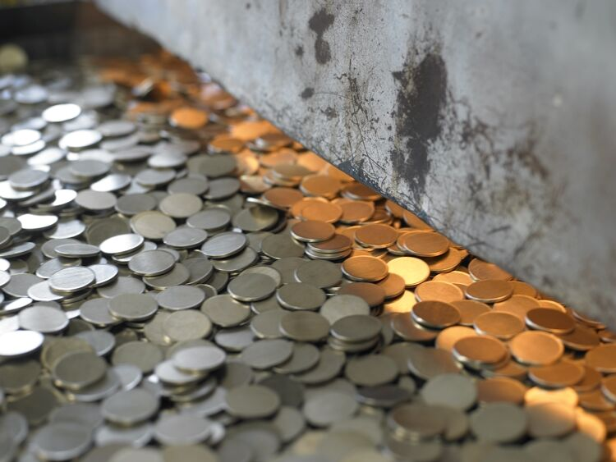
How Coins are Made
Step 3: Annealing and Cleaning
The mint then passes the coin blanks through in the annealing oven to soften the metal in preparation for striking.
From the furnace, they go to a cooling water bath, followed by a polishing/brightening rinse that removes any oil and dirt that may be on the surface of the coin.
Any foreign material can become embedded in the coin during the striking process, and it would have to be scrapped.

Slide 10
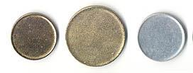
How Coins are Made
Step 4: Upsetting
Upsetting means to “upset” the edge of a coin to create a raised rim.
The upsetting mill feeds the blank into a groove slightly narrower than its diameter.
This pushes the metal up around the edge to form a rim.
This results in a planchet; a plain metal disk from which a coin is made.

Slide 11
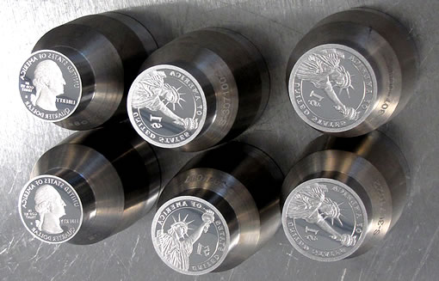
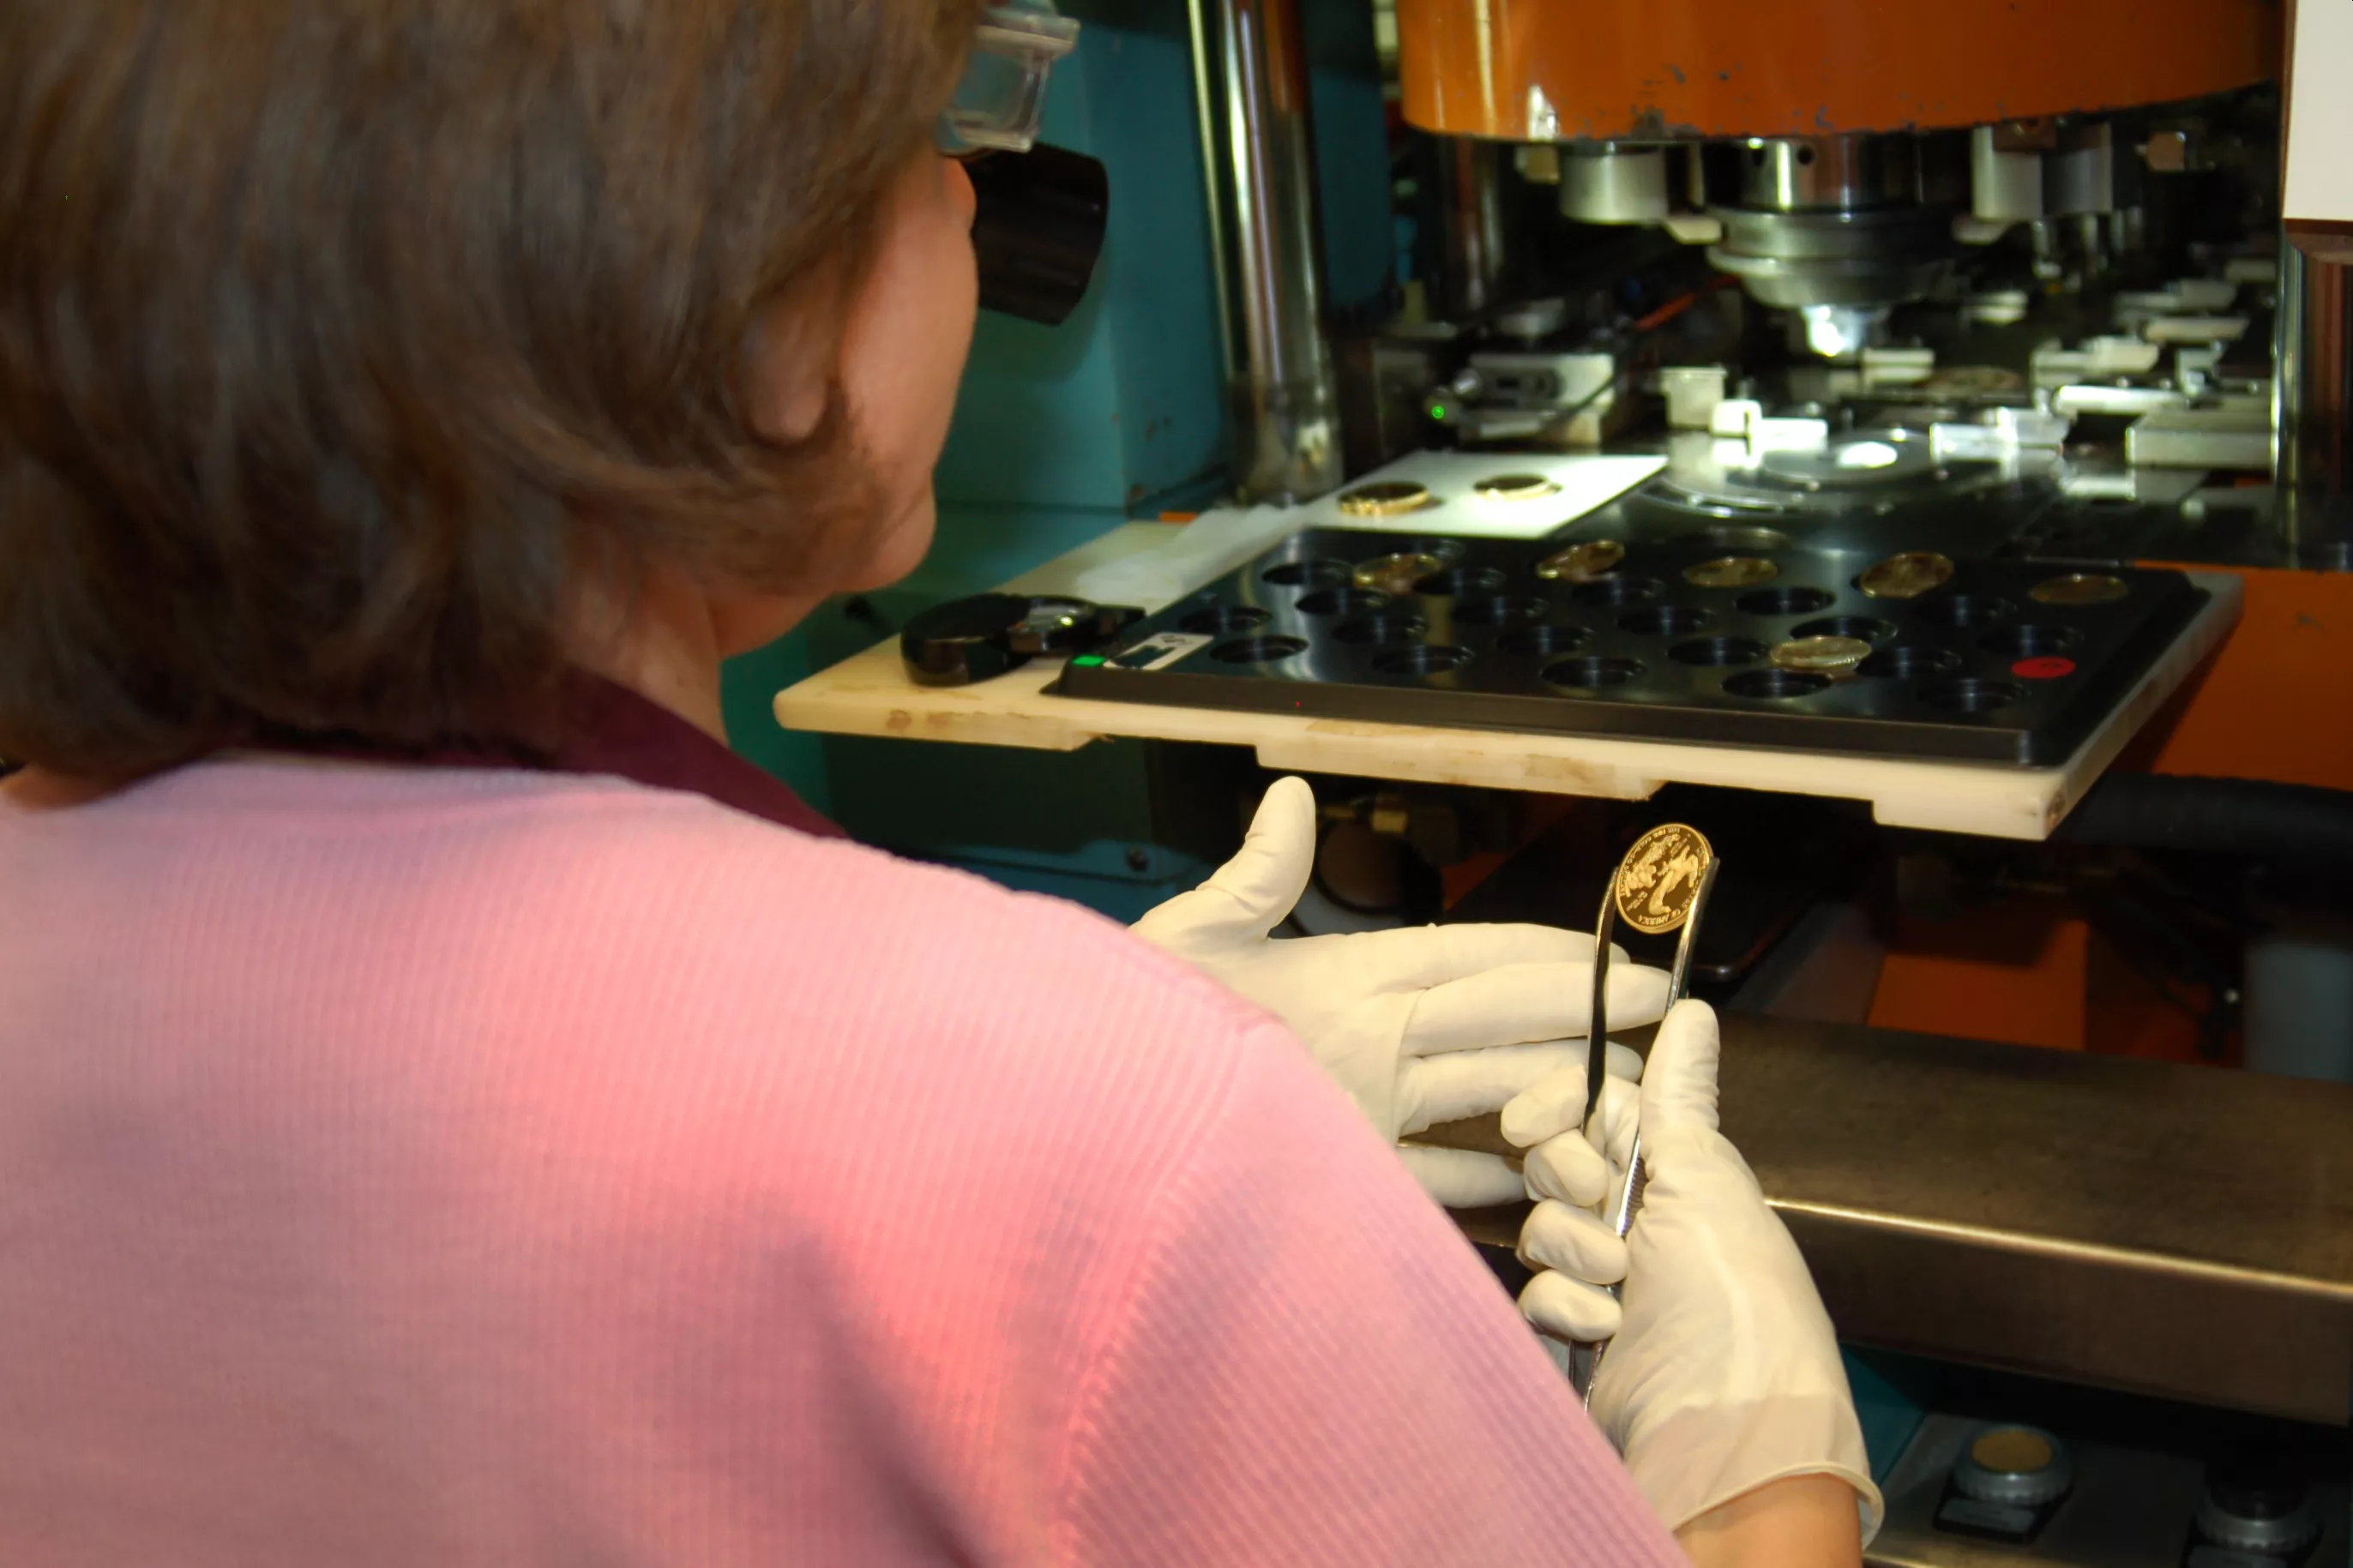
How Coins are Made
Step 5: Stamping or Striking
Now that the planchets have been properly prepared, softened, and cleaned, they are ready for striking.
They are automatically fed into the coining press at a rate that can reach several hundred coins per minute and are stamped with the designs and inscriptions which make them genuine United States coins.
Proof coins made for collectors are fed by hand into the coining press and receive at least two strikes per coin.

Slide 12
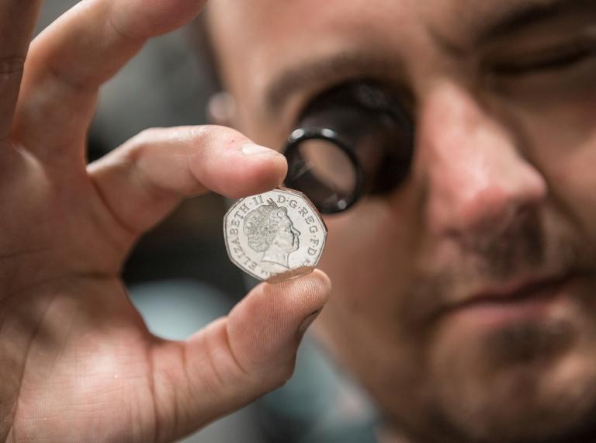
How Coins are Made
Step 6: Inspecting
Press operators using magnifying glasses spot-check each batch of newly struck coins.

Slide 13
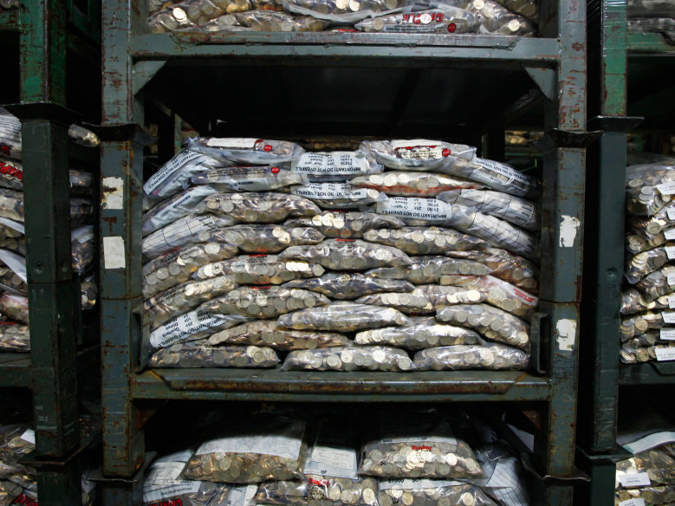
How Coins are Made
Step 7: Counting, Bagging, and Distribution
An automatic counting machine counts the coins and drops them into large bags.
The bags are sealed shut, loaded onto pallets, and taken by forklifts to the vaults for storage.
New coins are shipped by truck to Federal Reserve Banks for distribution to local banks.

Slide 14
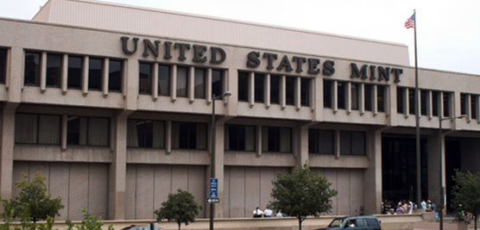
Active U.S. Mints
There are four active coin-producing mints:
Philadelphia
Denver
San Francisco
West Point.

Slide 15
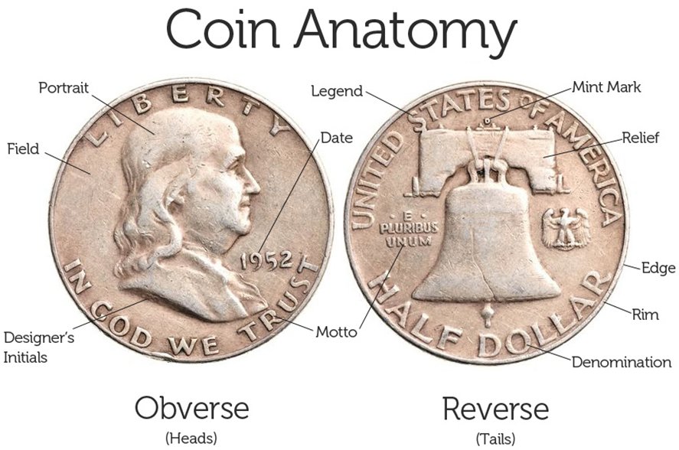
Requirement 2
Explain these collecting terms:
Obverse
Reverse
Reeding
Clad
Type set
Date set

Slide 16
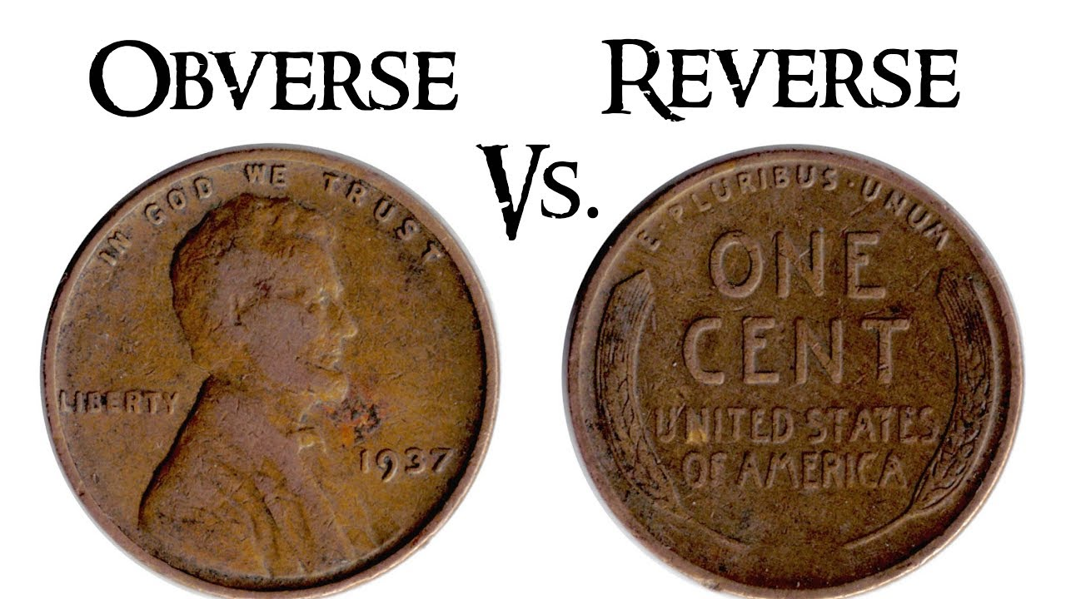
Obverse and Reverse
Obverse means the front face of the object and reverse means the back face.
The obverse of a coin is commonly called heads, because it often depicts the head of a prominent person, and the reverse tails.

Slide 17
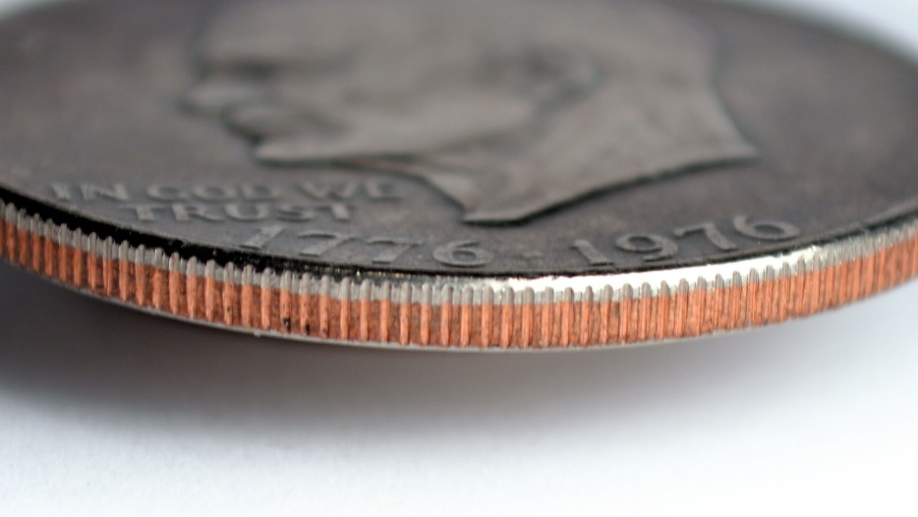
Reeding
The U.S. Mint began adding ridges to the coins' edges, a process called “reeding,” in order to make it impossible to shave them down without the result being obvious.
As a side benefit, the reeded edges also made coin design more intricate and counterfeiting more difficult.

Slide 18
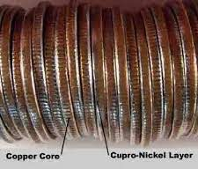
Clad
A clad coin is a coin that has multiple layers of metal in it.
Most current U.S. clad coins consist of an inner core of pure copper, with outer layers of a nickel-copper alloy that looks like silver.
Examples of this type of clad coin are the U.S. Quarter and Half Dollar.

Slide 19
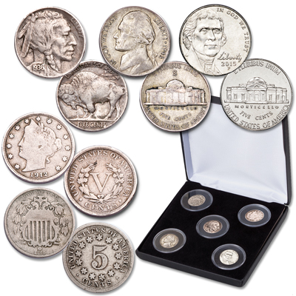
Type Set
Type set is a collection of coins based on denomination that includes all of the different designs.
For example, a nickel type set would contain one of each of the four types of nickels that the United States Mint has produced.

Slide 20
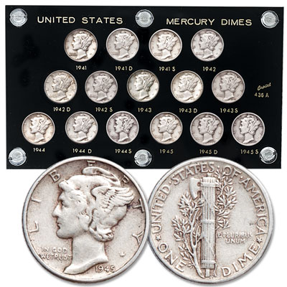
Date set
Date Set: a collection of coins of a single type and denomination that includes every year during a specific date span; for example, a Mercury dime from every year from 1916-1945.

Slide 21
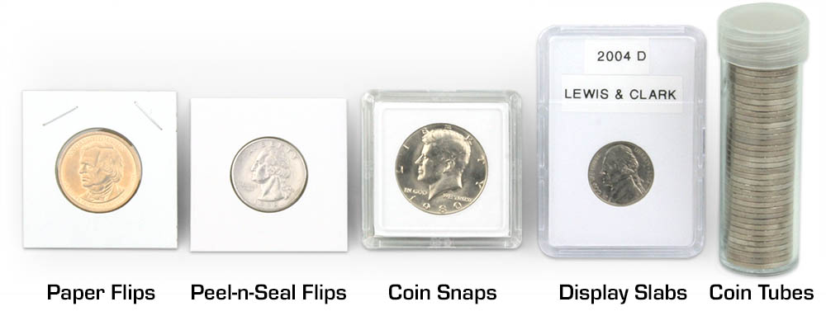
Requirement 3
Describe three different ways to store a collection, and the benefits, drawbacks, and cost of each method.

Slide 22
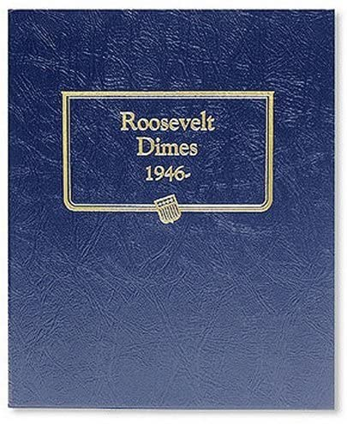
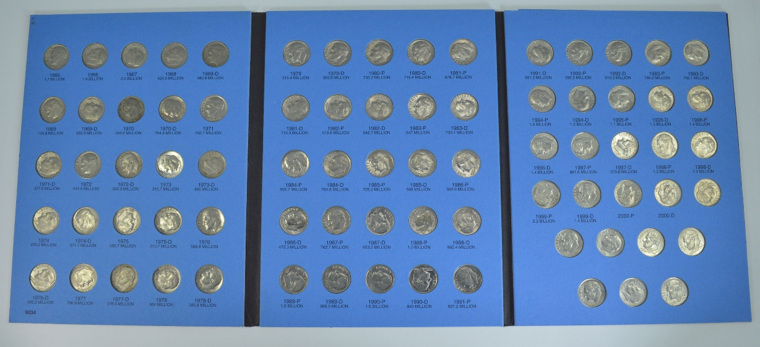
Storing Coins
Coin folders are an economical way to begin collecting.
These are the type of holder that requires you to “push” the coin into its slot.
There are no plastic slides to hold the coin in place.

Slide 23
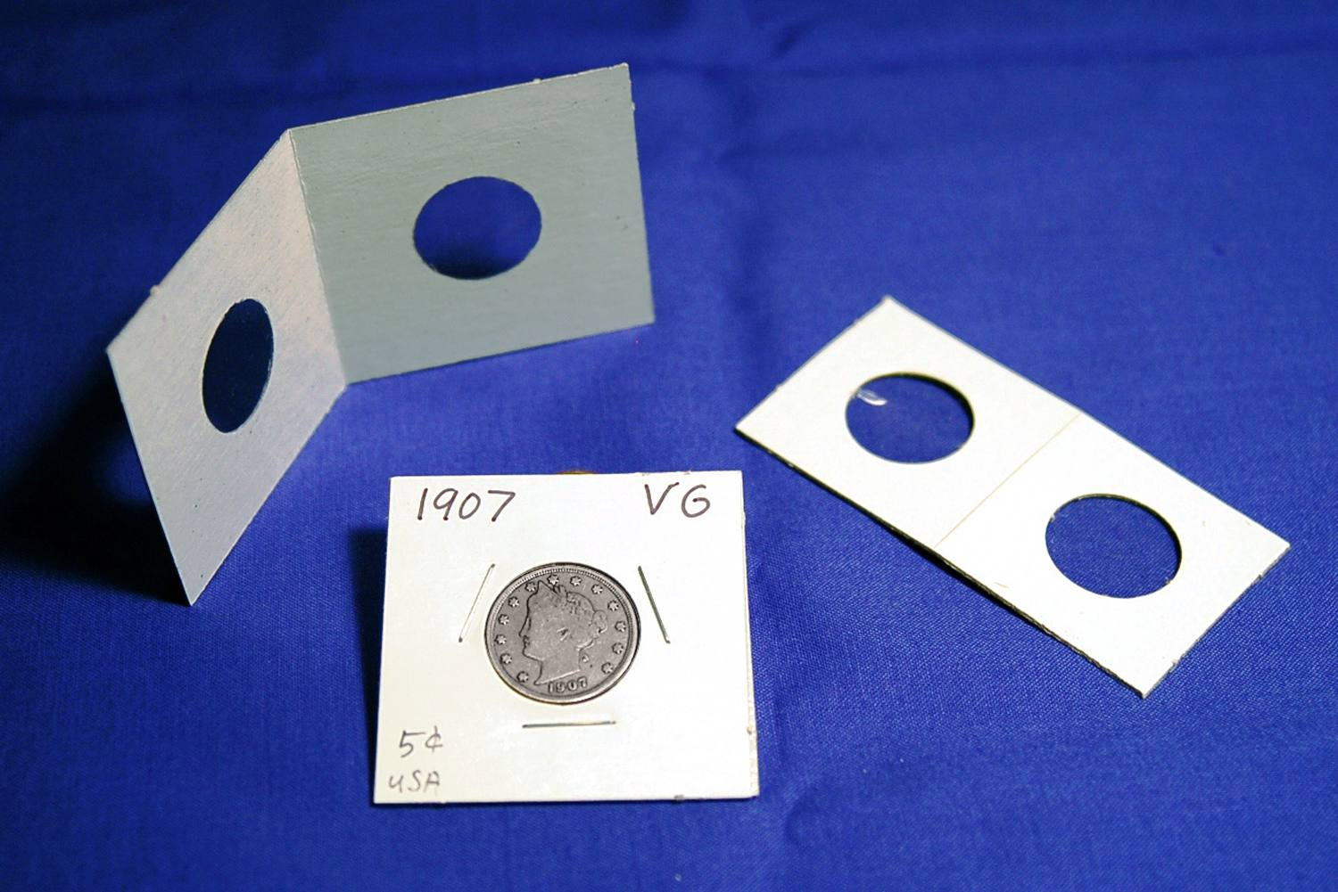
Storing Coins
One of the easiest ways to store coins is the use of two-by-two-inch Mylar holders.
This type of holder permits you to examine both sides of a coin and in such a manner that a fingerprint can not be left on the coin’s surface.
These holders are available in sizes to accommodate every denomination of coin.

Slide 24
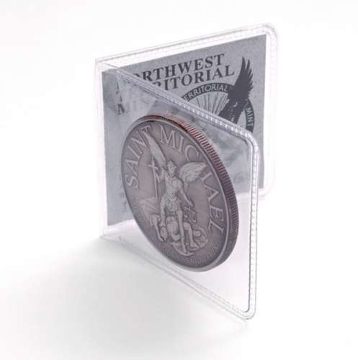
Storing Coins
Coin Collecting “flips”, also in a two-by-two-inch size are another choice.
These allow the viewing of both sides of the coin as well as the edge.
The flip is divided into two sections.
The front section is for the coin while the back section is reserved for the paper two-by-two card on which you may enter the date, denomination, grade and any other information that you require.

Slide 25
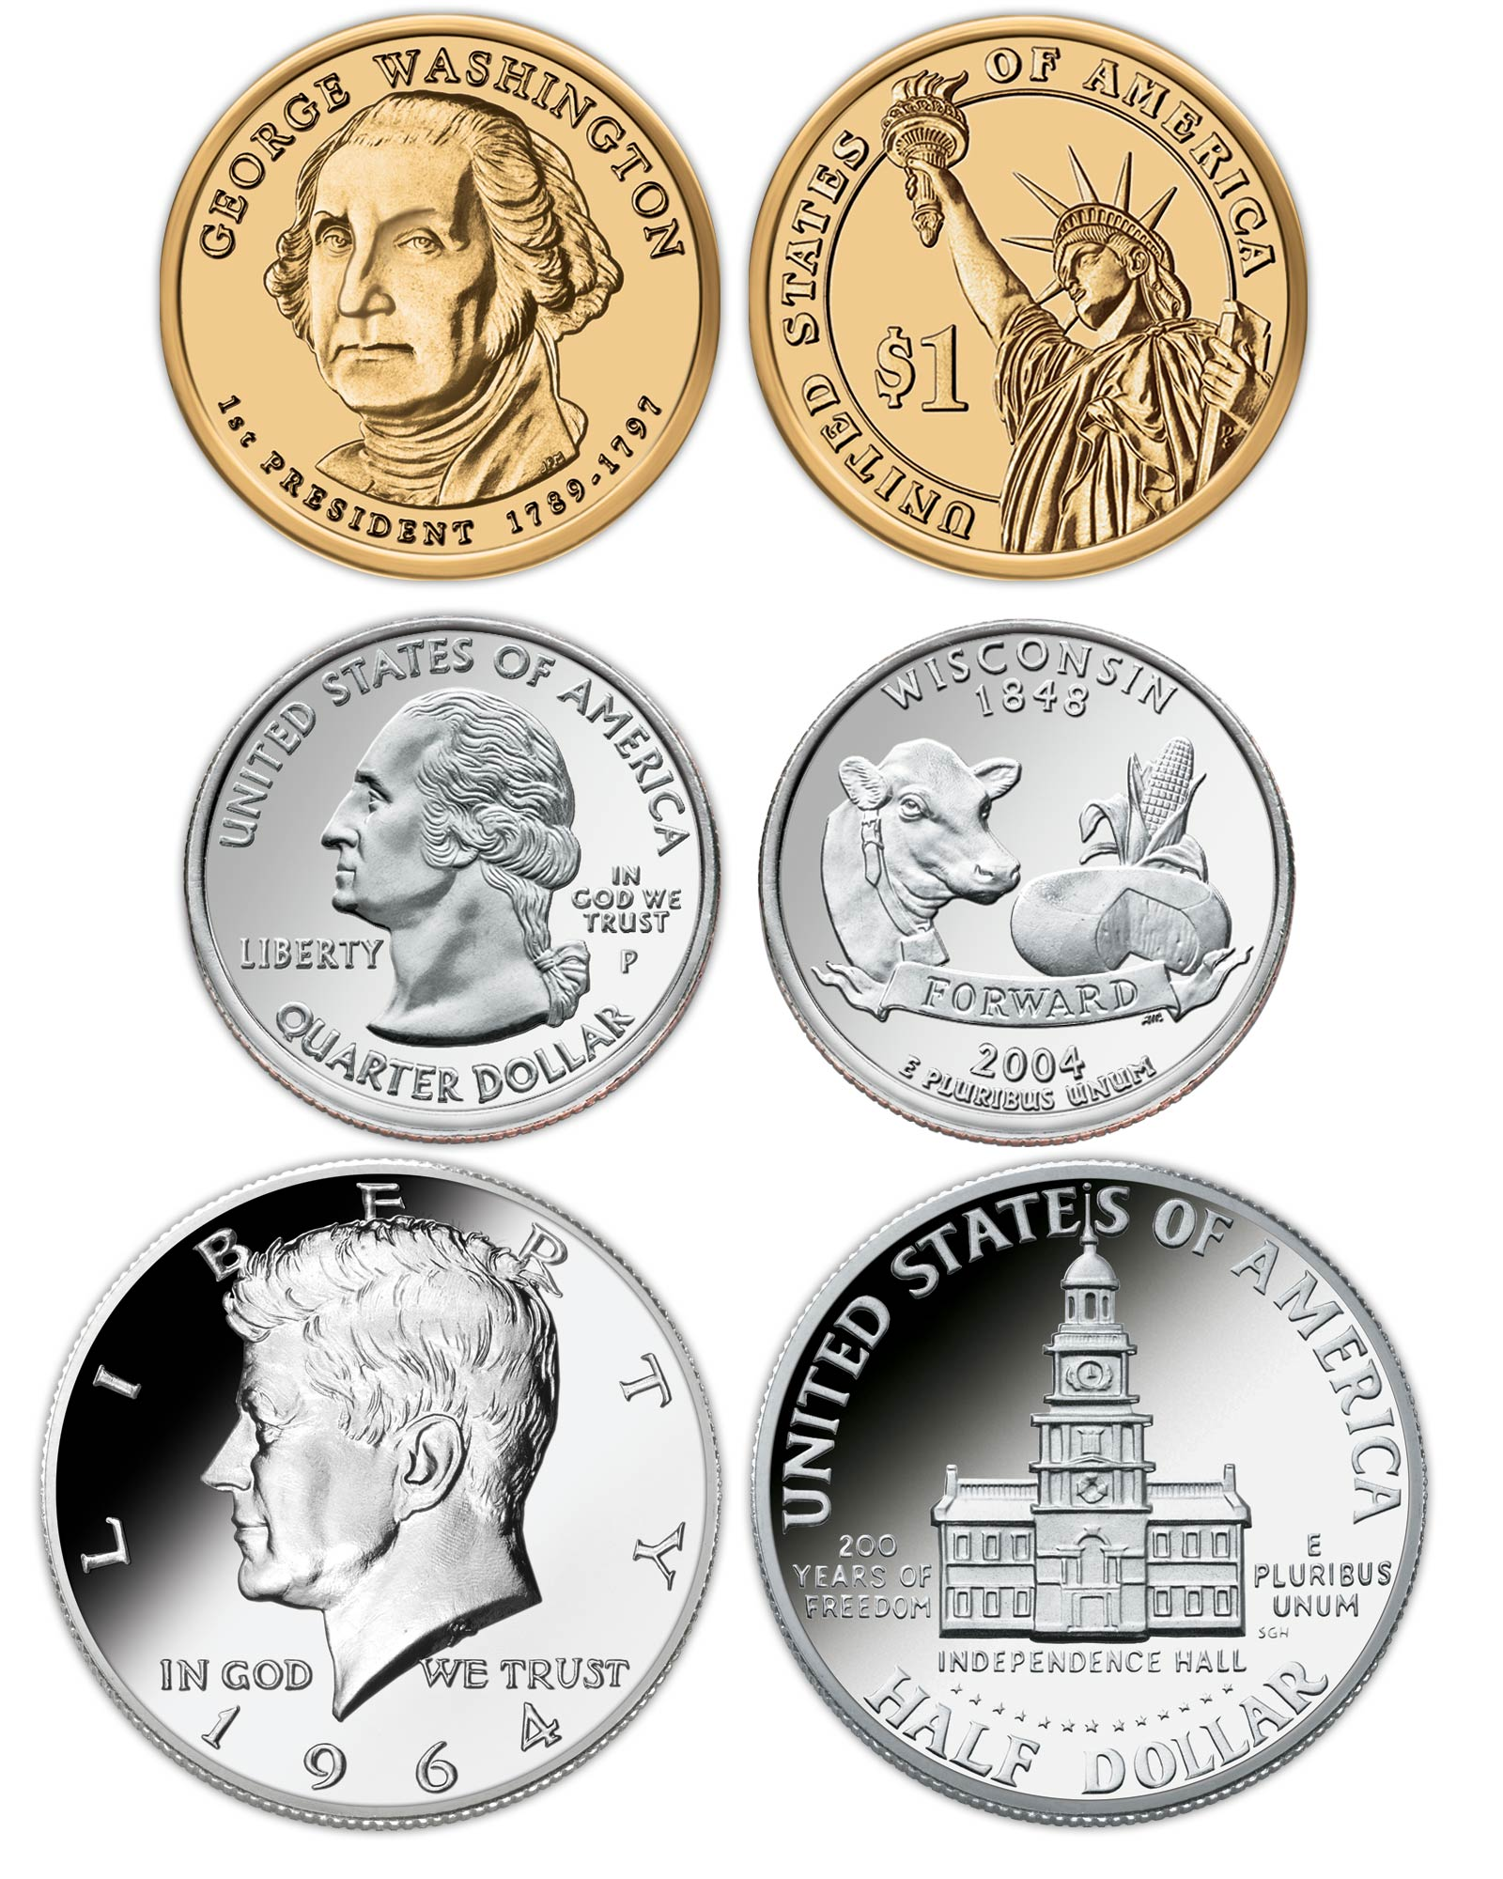
Requirement 4
Do each of the following and explain to your counselor the design features, designer name, designer initials, and where to find them for each item:
Collect a one-cent coin from the year group: 1959-2008 (that is, dated between 1959 and 2008) and a one-cent coin from the year group 2010-present. Explain how and why the one-cent coins issued in 2009 were different from either of the other two year groups.
Collect two five-cent coins, one from each of these year groups: 1959- 2003 and 2006-present. Explain how and why the five-cent coins issued in 2004-2005 were different from either of the other two year groups.
Collect a ten-cent coin from 1965-present.
Collect a twenty-five-cent coin from 1965-1998, two examples from the 50-State Quarter®/territories Program 1999-2009, two designs from the America the Beautiful® program 2012-2021 and two designs from the American Woman Quarter® program (2022-2024). Explain the purpose of each of those programs.
Collect a half dollar coin from 1965-present.
Collect a dollar coin from each of these design groups: Susan B. Anthony 1979-81, Sacagawea 1990-2005, U.S. Presidents 2000-2014.

Slide 26
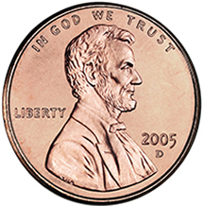
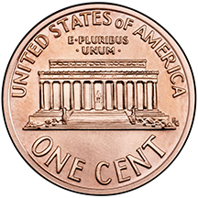
One Cent: 1959-2008
The “Lincoln Memorial” penny design was introduced in 1959. This design was last made in 2008.
Characteristics
Obverse (heads): Features the image of President Abraham Lincoln used on the penny since 1909.
Reverse (tails): Depicts the Lincoln Memorial.
Obverse Inscriptions
LIBERTY
IN GOD WE TRUST
Year
Reverse Inscriptions
UNITED STATES OF AMERICA
E PLURIBUS UNUM
ONE CENT
Artist Information
Obverse Designer: Victor D. Brenner
VDB is on the rim, just under the shoulder of Lincoln.
Reverse Designer: Frank Gasparro
FG appears on the right of the design, near the shrubbery.

Slide 27
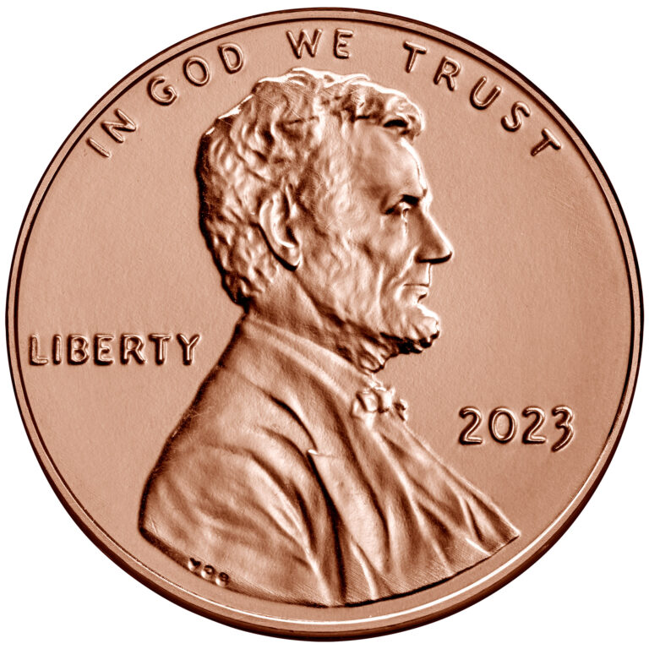
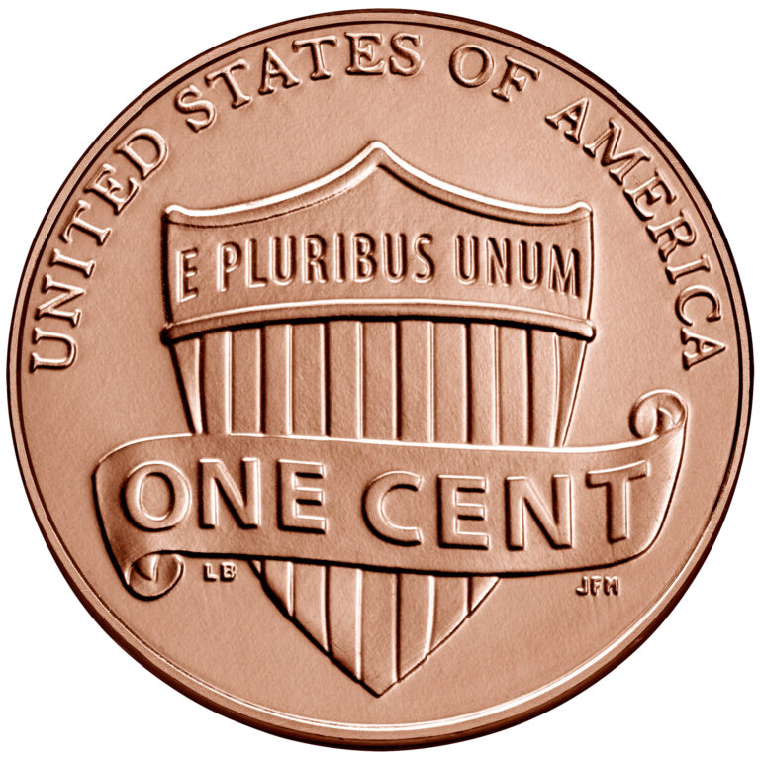
One Cent: 2010-Present
Characteristics
Obverse (heads): Shows the familiar likeness of President Abraham Lincoln featured since 1909.
Reverse (tails): First issued in 2010 and emblematic of Lincoln’s preservation of the United States as a single and united country. It features a union shield with 13 vertical stripes and our national motto in a horizontal bar above. A banner drapes across the front.
Obverse Inscriptions
LIBERTY
IN GOD WE TRUST
Year
Reverse Inscriptions
UNITED STATES OF AMERICA
E PLURIBUS UNUM
ONE CENT
Mint and Mint Mark
Denver
Philadelphia
Artist Information
Obverse Designer: Victor D. Brenner
Reverse Sculptor: Joseph Menna, Medallic Artist
Designer: Lyndall Bass

Slide 28
Cent
Designer Initials
Mint Mark
Designer Initials

Slide 29
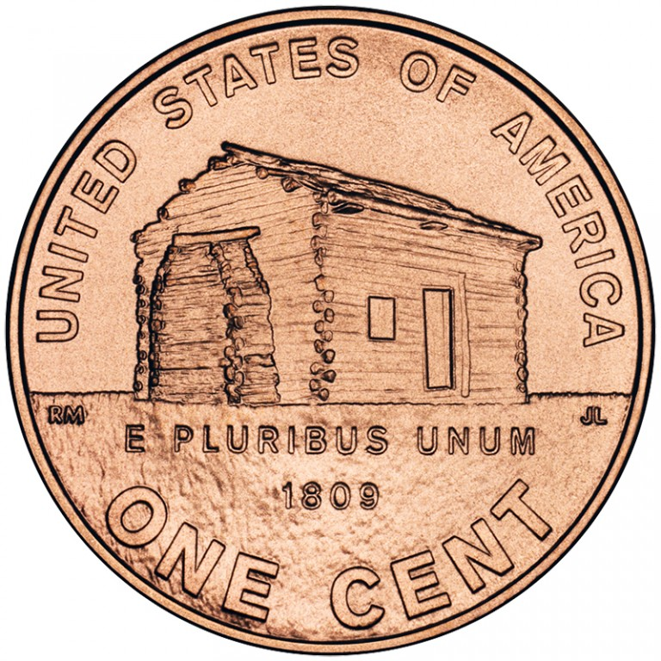
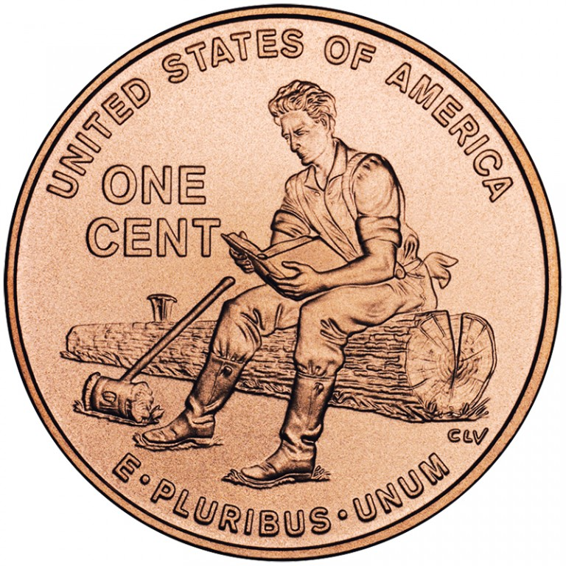
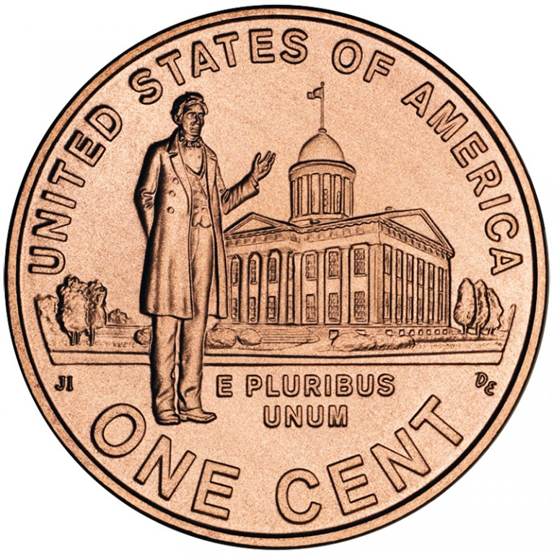
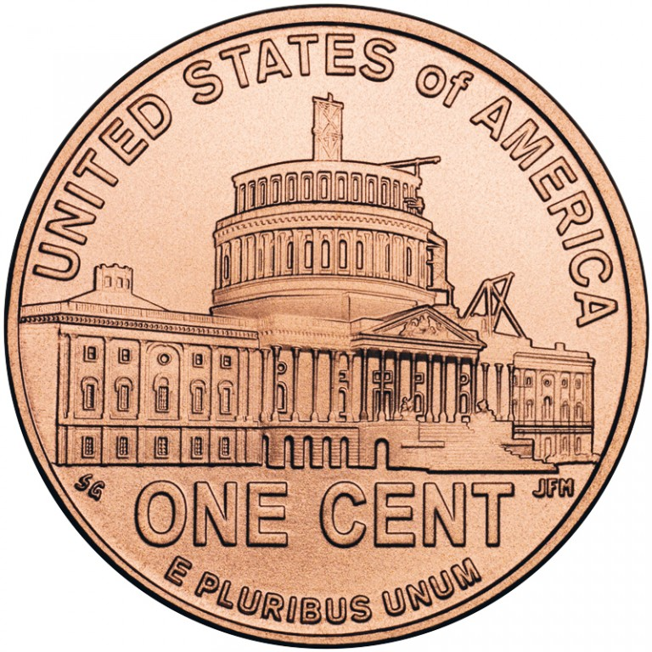
One Cent: 2009
Lincoln Bicentennial One Cent Program
In 2009, the United States Mint issued four different pennies as part of the Lincoln Bicentennial One Cent Program. The program recognized not only of the 200th anniversary of Abraham Lincoln’s birth, but also the 100th anniversary of the Lincoln cent, first appearing in 1909. The themes on the reverses represent the four major aspects of Lincoln’s life:
Birth and Early Childhood in Kentucky (1809-1816)
Formative Years in Indiana (1816-1830)
Professional Life in Illinois (1830-1861)
Presidency in Washington, DC (1861-1865)
The circulating version of these coins uses the same metal content as other modern cents (2.5 percent copper, the rest zinc). The uncirculated version contains the metals used in the original 1909 cent (95 percent copper, 5 percent tin and zinc).
After the program ended, the design on the back of the one-cent coin changed to represent the unity of the states, which President Lincoln worked so hard to restore and preserve.

Slide 30
Five Cent: 1959-2003
Jefferson took his place on the obverse of the nickel in 1938 with Monticello, his Virginia home, on the reverse.
These designs, both by Felix Schlag, continued until 2003.
His initials are under Jefferson’s shoulder on the obverse side.

Slide 31
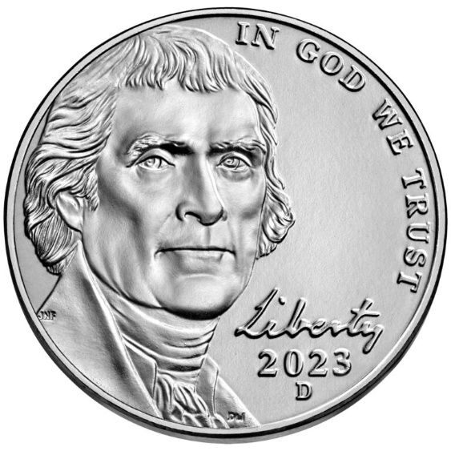
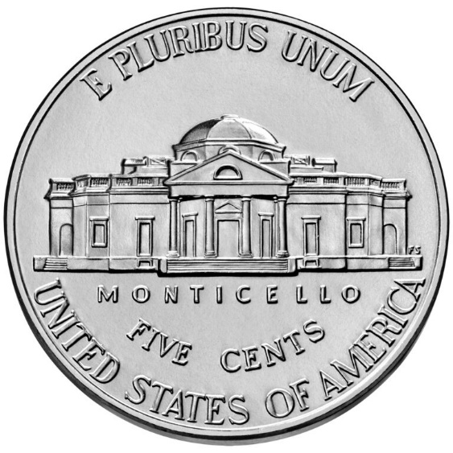
Five Cent: 2006-Present
The “Return to Monticello” theme is the current design of the U.S. five-cent coin. The U.S. Mint first issued this design in 2006.
Characteristics
Obverse (heads): Shows, since 2006, the Thomas Jefferson likeness based on a Rembrandt Peale portrait completed in 1800. Peale’s portrait was the basis for most of the images of Jefferson made during his lifetime.
Reverse (tails): Features the classic rendition of Monticello
Obverse Inscriptions
IN GOD WE TRUST
LIBERTY (in cursive, based on Jefferson's handwriting)
Year
Reverse Inscriptions
UNITED STATES OF AMERICA
E PLURIBUS UNUM
FIVE CENTS
MONTICELLO
Mint and Mint Mark
Denver
Philadelphia
San Francisco
Artist Information
Obverse Sculptor: Donna Weaver, Sculptor-Engraver
Designer: Jamie Franki, Artistic Infusion Program
Reverse Designer: Felix Schlag

Slide 32
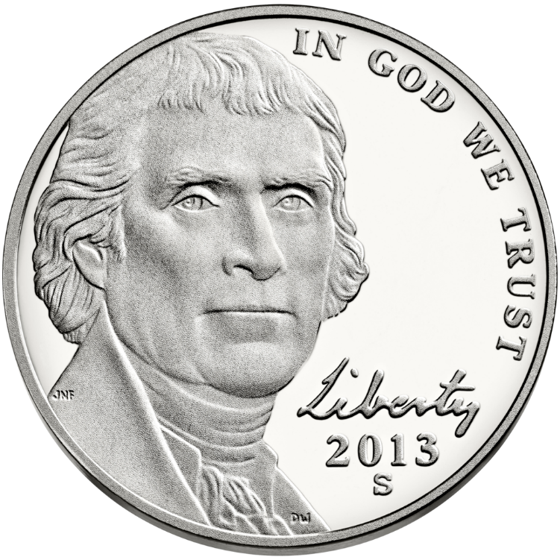
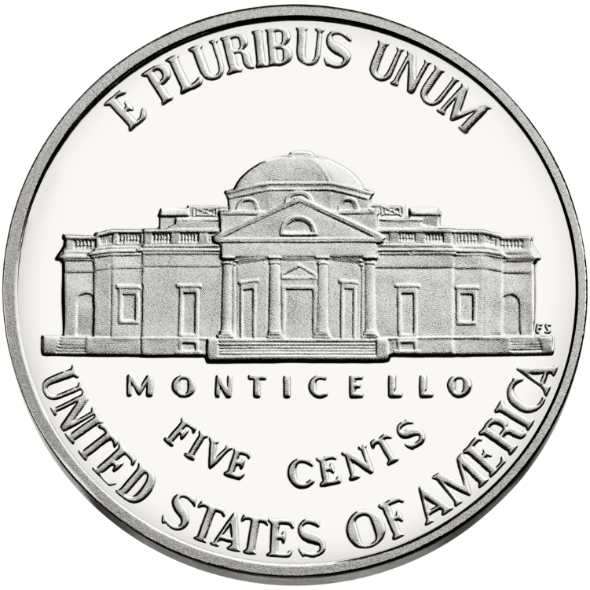
Nickel
Designer Initials
Mint Mark
Designer Initials

Slide 33
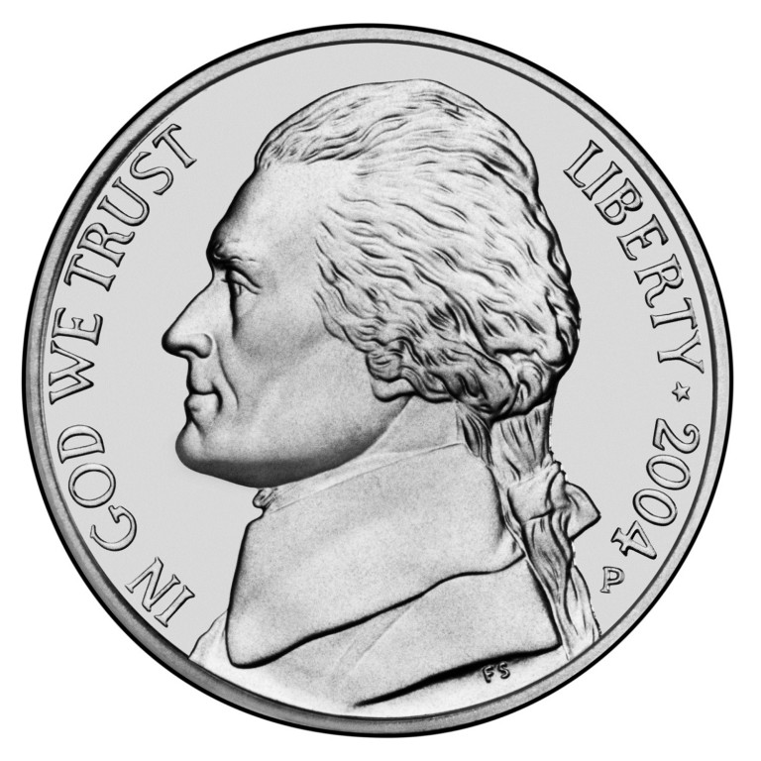
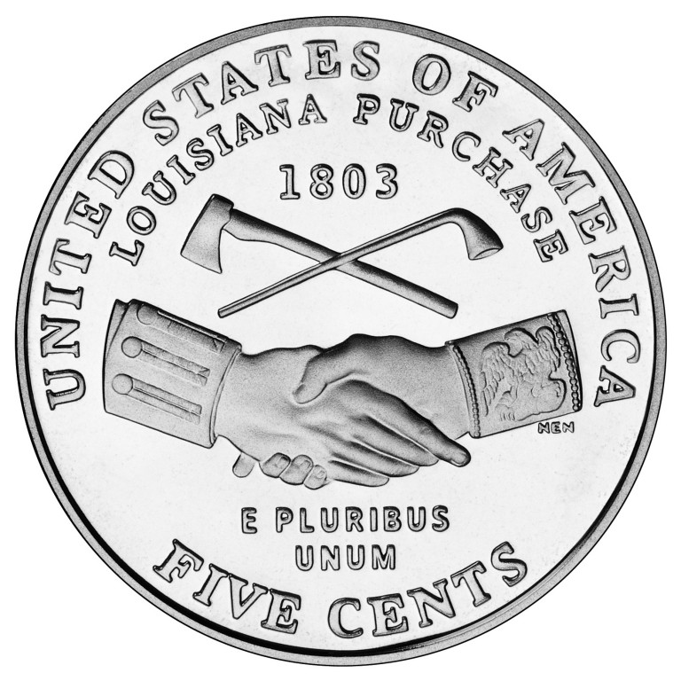
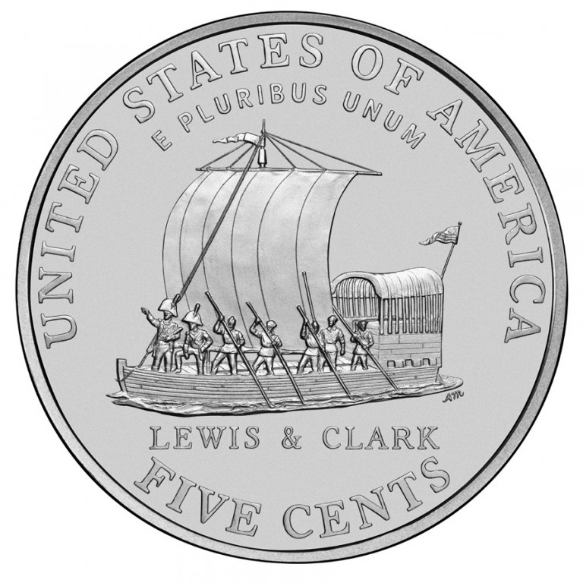
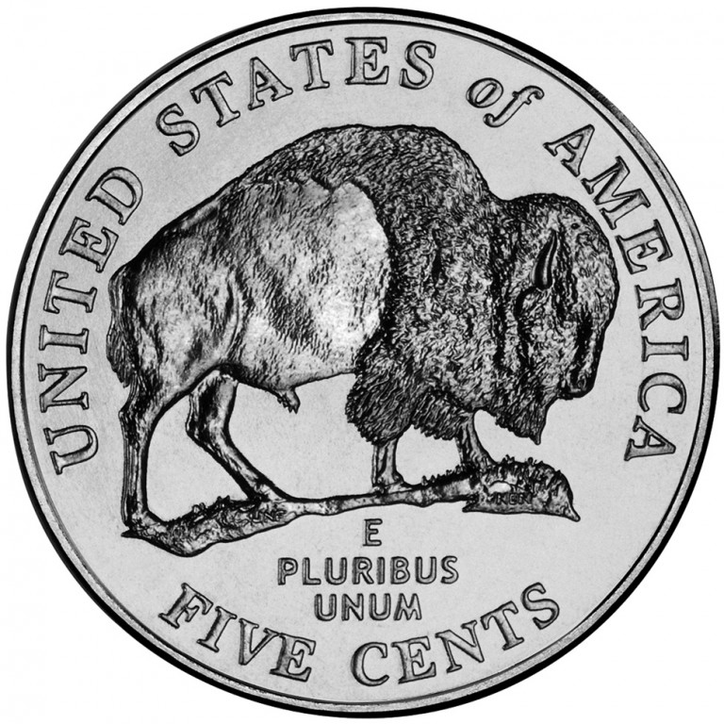
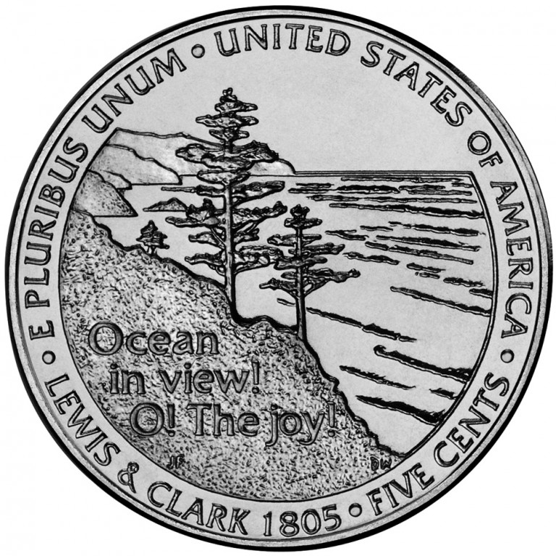
Five Cent: 2004-2005
Westward Journey Nickel Series
In 2004 and 2005, the Jefferson nickel featured four different designs to commemorate the bicentennials of the Louisiana Purchase and the Lewis and Clark expedition.
The images were evocative of the historic expedition into the Louisiana Territory.
The U.S. Mint began the Westward Journey Nickel Series in 2004 with the release of the “Peace Medal” and “Keelboat” nickels.
In 2005, a new likeness of Thomas Jefferson appeared on the obverse in recognition of his role in the Louisiana Purchase and commissioning the Lewis and Clark expedition.
The “American bison” reverse was representative of the wildlife encountered by the expedition.
The second coin of 2005 depicted a scene of the Pacific Ocean, highlighting the expedition’s exultation on believing they had finally reached the Pacific Ocean after many months of travel.

Slide 34
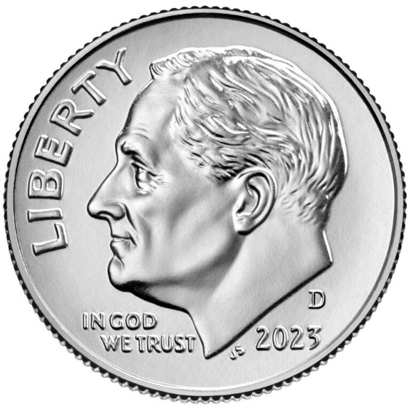
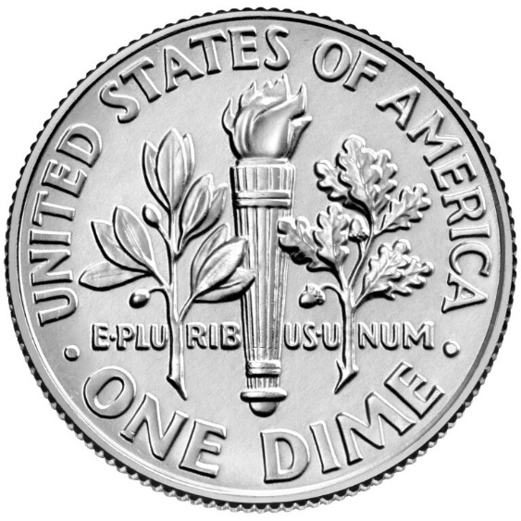
Ten Cent: 1965-Present
The “Roosevelt” theme is the current design of the U.S. 10-cent coin. The U.S. Mint first issued this design in 1946, soon after the death of President Franklin D. Roosevelt.
Characteristics
Obverse (heads): Shows the left-facing bust of Franklin D. Roosevelt, featured since 1946.
Reverse (tails): Displays a torch with an olive branch to the left of it and an oak branch to the right. The torch signifies liberty, the olive branch peace, and the oak branch represents strength and independence.
Obverse Inscriptions
LIBERTY
IN GOD WE TRUST
Year
Reverse Inscriptions
UNITED STATES OF AMERICA
E PLURIBUS UNUM
ONE DIME
Mint and Mint Mark
Denver
Philadelphia
San Francisco
Artist Information
John Sinnock

Slide 35
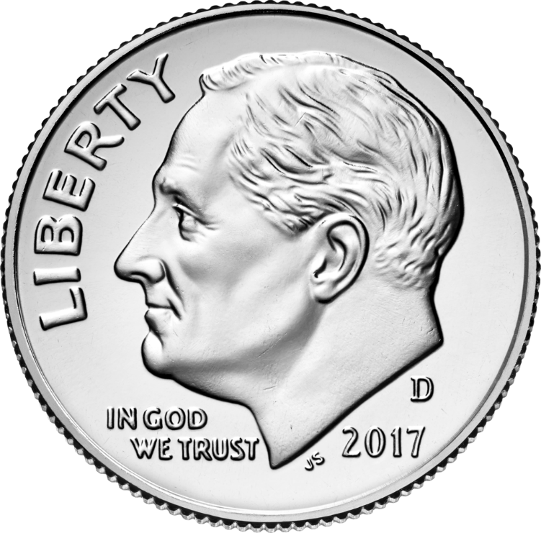
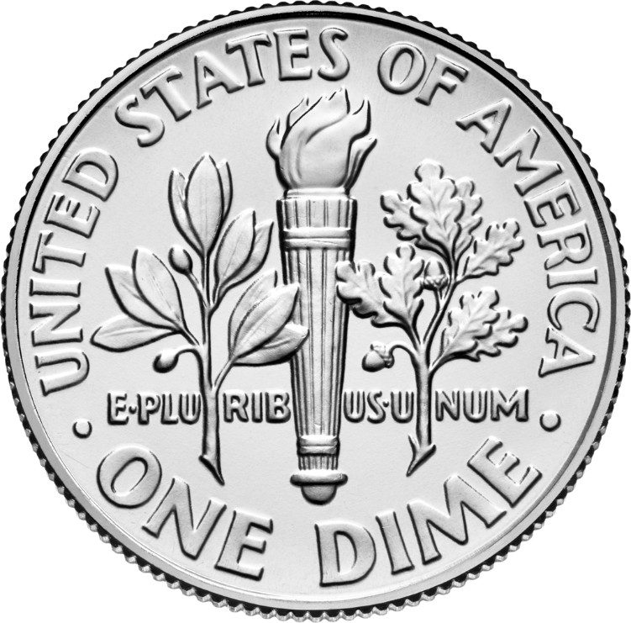
Dime
Designer Initials
Mint Mark

Slide 36
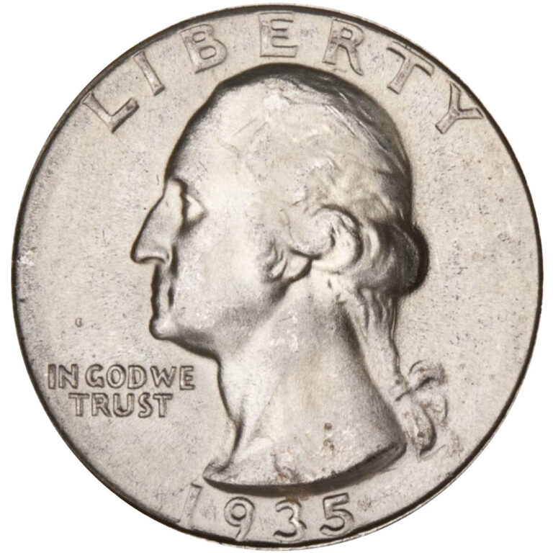
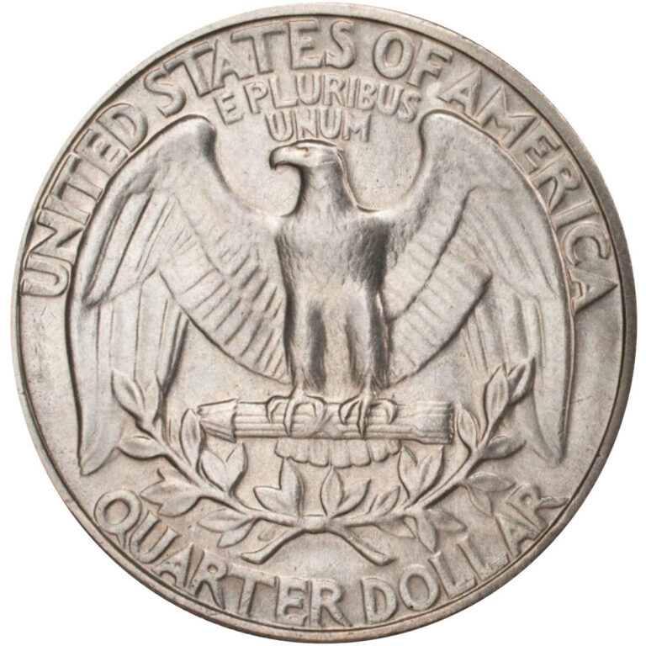
25 Cent: 1965-1998
In 1932, an image of George Washington designed by John Flanagan replaced Liberty on the obverse of the quarter to honor Washington’s 200th birthday.
In 1965, the Mint removed silver from the quarter and the composition became copper-nickel clad.
Characteristics
The obverse (heads) design features a bust of George Washington by John Flanagan.
The reverse (tails) features an eagle with wings spread, standing on a bundle of arrows with two olive sprays beneath it.
Obverse Inscriptions
LIBERTY
IN GOD WE TRUST
Year
Reverse Inscriptions
UNITED STATES OF AMERICA
E PLURIBUS UNUM
QUARTER DOLLAR
Mint and Mint Mark
Denver
Philadelphia
Artist Information
Designer: John Flanagan whose initials can be found at the base of Washington's neck.

Slide 37
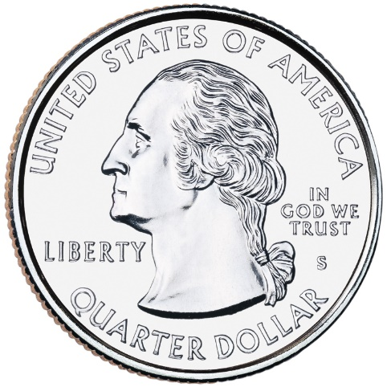
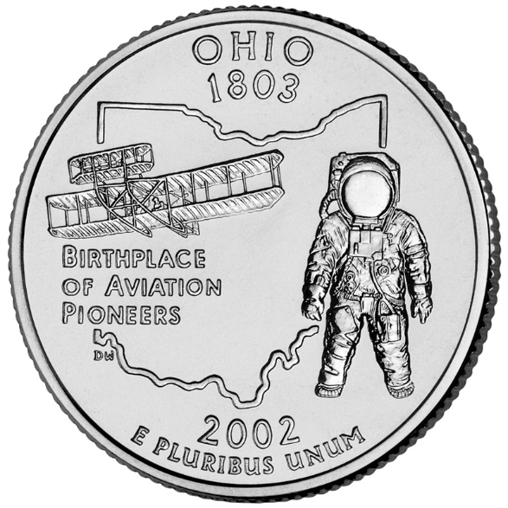
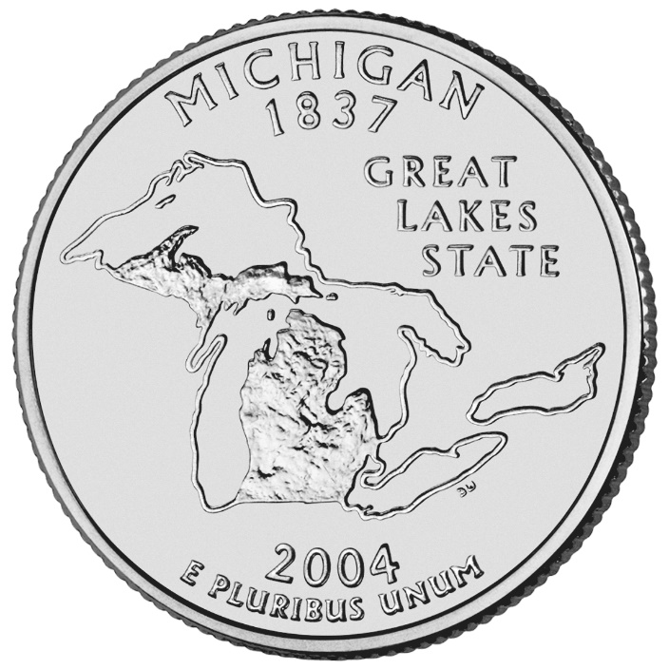
25 Cent: 1999-2009
50-State Quarter®/territories Program was launched in 1999.
It was a 10-year initiative that honored each of the nation’s states in the order that they ratified the Constitution or were admitted into the Union.
Each quarter was produced for about 10 weeks and will never be produced again.
State designs are displayed on the reverse (tails) of the quarters, while the obverse design displays the familiar image of George Washington.
But, to accommodate state designs on the reverse, the words “United States of America,” “Quarter Dollar,” “Liberty,” and “In God We Trust” all appear on the obverse.

Slide 38
25 Cent: 1999-2009

Slide 39
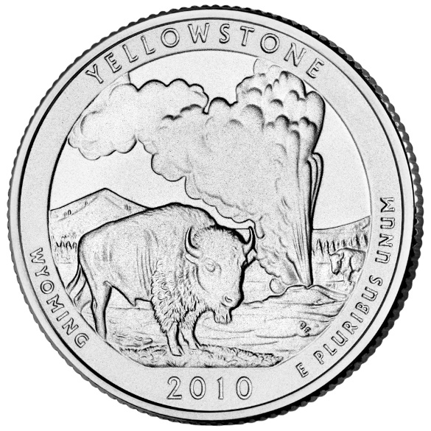
25 Cent: 2012-2021
From 2010 through 2021, the U.S. Mint issued 56 quarters as part of the America the Beautiful Quarters Program.
The reverse designs depicted a national park or other national site for each U.S. state, territory, and the District of Columbia.

Slide 40
America the Beautiful Quarters Program
The America the Beautiful quarters are a series of 56 quarters issued by the United States Mint starting in 2010 and scheduled to continue until 2021.
The obverse (front) of all the coins depicts George Washington in a modified version of the portrait used for the original 1932 Washington quarter.
There will be five new reverse (back) designs each year and one in 2021, each commemorating a national park or national site – one from each state, the federal district, and each territory.
The program is authorized by the America’s Beautiful National Parks Quarter Dollar Coin Act of 2008.

Slide 41
25 Cent: 2022-2024
The American Women Quarters™ Program is the current U.S. 25-cent coin program, spanning 2022 to 2025.
The obverse (heads) shows a right-facing portrait of George Washington.
The reverse (tails) features five designs each year honoring American women and their contributions.

Slide 42
Half Dollar: 1965-Present
The “Kennedy” theme is the current design of the U.S. 50-cent coin.
The U.S. Mint first issued this design in 1964, a year after the assassination of President John F. Kennedy.
Characteristics
Obverse (heads): Shows a profile of President John F. Kennedy based on a portrait prepared for his presidential medal.
Reverse (tails): Depicts the Presidential Seal. It consists of a heraldic eagle with a shield holding an olive branch and a bundle of 13 arrows. The olive branch symbolizes peace and the arrows symbolize war. A ring of 50 stars to represent the states surrounds the design.
Obverse Inscriptions
LIBERTY
IN GOD WE TRUST
Year
Reverse Inscriptions
UNITED STATES OF AMERICA
HALF DOLLAR
E PLURIBUS UNUM
Mint and Mint Mark
Denver
Philadelphia
San Francisco
Artist Information
Obverse Sculptor: Gilroy Roberts
Reverse Sculptor: Frank Gasparro

Slide 43
Half Dollar
Mint Mark
Designer Initials

Slide 44
Dollar: Susan B. Anthony 1979-81
The Susan B. Anthony Dollar was the first time that a woman appeared on a U.S. circulating coin.
The coin replaced the Eisenhower Dollar and was minted from 1979-1981 and again in 1999.
It honored women’s suffrage leader, Susan B. Anthony.
Characteristics
The obverse (heads) features the likeness of Susan B. Anthony.
The reverse (tails) shows an American eagle landing on the Moon, an adaptation of the Apollo 11 insignia used on the Eisenhower Dollar.
Obverse Inscriptions
LIBERTY
IN GOD WE TRUST
Date
Reverse Inscriptions
UNITED STATES OF AMERICA
E PLURIBUS UNUM
ONE DOLLAR
Mint and Mint Mark
Denver
Philadelphia
Artist Information
Designer: Frank Gasparro whose initials FG appear just below Anthony’s left shoulder.

Slide 45
Dollar: Sacagawea 1990-2005
The U.S. Mint issued the Sacagawea Golden Dollar from 2000 to 2008.
Characteristics
Obverse Design
The Golden Dollar's obverse, or heads, has a portrait of Sacagawea.
On her back, Sacagawea carries Jean Baptiste, her infant son.
Reverse Design
The reverse features a soaring eagle encircled by 17 stars. The 17 stars represent each state in the Union at the time of the 1804 Lewis and Clark expedition.
Obverse Inscriptions
LIBERTY
IN GOD WE TRUST
Year
Reverse Inscriptions
UNITED STATES OF AMERICA
E PLURIBUS UNUM
ONE DOLLAR
Mint and Mint Mark
Denver
Philadelphia
San Francisco
Artist Information
Obverse Designer: Glenna Goodacre
Reverse Designer: Thomas Rogers

Slide 46
Dollar
Designer Initials
Mint Mark
Designer Initials

Slide 47
Dollar: U.S. Presidents 2000-2014
The United States Mint honors our nation’s presidents by issuing $1 coins featuring their images in the order that they served.
The program began in 2007 with Presidents Washington, Adams, Jefferson, and Madison.
Characteristics
Obverse Inscriptions
(NAME OF PRESIDENT)
(WHEN THEY SERVED)
Reverse Inscriptions
UNITED STATES OF AMERICA
$1
Incused (edge) Inscriptions
(DATE OF ISSUE)
E PLURIBUS UNUM
IN GOD WE TRUST
mint mark ("P", "D," or "S")

Slide 48
Requirement 5
Describe and discuss with your counselor the special reverse designs of the quarters, half dollar and dollar coin struck in 1975-1976 to honor the U.S. Bicentennial.

Slide 49
U.S. Bicentennial: Quarters
The coin was minted in the years 1975 and 1976 and carried the dual dates of 1776-1976 in celebration of the 200th anniversary of the independence of the United States.
During the release of the Bicentennial coinage, no coins of this denomination carried the single date of 1975 or 1976.
The reverse features a Colonial drummer facing left and a victory torch encircled by thirteen stars at the upper left.

Slide 50
U.S. Bicentennial: Half Dollar
A temporary reverse featuring Independence Hall in Philadelphia appeared in 1975 and 1976 to celebrate the bicentennial of the Declaration of Independence.

Slide 51
U.S. Bicentennial: Dollar Coin
The Bicentennial dollar, picturing the Liberty Bell and moon on the reverse and the double date 1776-1976 beneath the portrait of President Eisenhower on the obverse,

Slide 52
Requirement 6
Identify for your counselor the people depicted on current currency: $1, $2, $5, $10, $20, $50, and $100 notes. Explain where United States currency is printed.

Slide 53
Portraits on U.S. Paper Currency
$1 George Washington
$2 Thomas Jefferson
$5 Abraham Lincoln
$10 Alexander Hamilton
$20 Andrew Jackson
$50 Ulysses S Grant
$100 Benjamin Franklin

Slide 54
Printing of U.S. Currency
Since 1862, the Bureau of Engraving and Printing (BEP) been entrusted with the mission of manufacturing the nation’s currency.
All U.S. currency is printed at the facilities in Washington, D.C. and Fort Worth, Texas.
In addition to manufacturing U.S. paper currency, BEP also prints a variety of U.S. government security documents.

Slide 55
Bureau of Engraving and Printing
Washington, DC Facility Department of the Treasury Bureau of Engraving and Printing 14th and C Streets, SW Washington, DC 20228
Public Tours: 1-866-874-2330
Fort Worth, TX Facility Department of the Treasury Bureau of Engraving and Printing 9000 Blue Mound Road Fort Worth, TX 76131
Public Tours: 1-866-865-1194

Slide 56
Requirement 7
Do ONE of the following:
Collect and identify for your counselor 20 different world coins from at least 7 different countries. Identify the country, major design elements, and denomination of each.
Collect and identify for your counselor 20 different world paper money from at least 7 different countries. Identify the country, major design elements, and denomination of each.
Collect and identify for your counselor 20 different tokens and/or medals. Identify the issuer and use of each.
Complete one of the following and report to your counselor what you experienced:
Attend a coin show
Attend a coin club meeting
Tour a U.S. Mint facility or museum
Tour a virtual exhibit (with your parent or guardian’s permission) approved by your counselor.

Slide 57
Foreign Coins and Bank Notes
Many banks offer to exchange U.S. currency for foreign currency to their customers.
There may be a small fee if you exchange less than a certain amount.
Another way to start collecting foreign coins and bank notes is by attending local coin auctions.
Coin auctions allow you to buy, sell and find values for foreign currency.
Another option would be to travel to a country and exchange U.S. currency for foreign currency directly.

Slide 58
Tokens and Medals
A token is a coin-like object that is usually made of metal and represents a particular value or coin.
Token are sometimes referred to as "Good Fors" because they may be "Good For" or exchangeable for a particular item (like one glass of soda) or service (like one hair cut).
Some can be traded for actual money, most cannot.
Tokens can advertise a particular merchant or product and can be very interesting and fun to collect.
A medal is a coin-like object that is struck for award, celebration or commemoration.
Unlike a token or coin, they have no stated value.
Medals can be beautiful, elaborate pieces of art and are highly collectible.

Slide 59
Coin Shows
Find a coin show near you in the US Coin Show Directory.

Slide 60
Coin Clubs
Are you interested in discovering and exploring the world of money with other people who share your interests?
There are more than 300 American Numismatic Association (ANA) member coin clubs in the United States and other countries.
The Club Directory can help you find a club based on your location and/or collecting interest.

Slide 61
U.S. Mint Facility/Museum
The U.S. Mint offers free in-person tours of the Philadelphia and Denver facilities, which cover the present state of coin manufacturing and the history of the Mint.
Visitors learn about the craftsmanship required at all stages of the minting process, from the original designs and sculptures to the actual striking of the coins.

Slide 62
U.S. Mint at Philadelphia Tour
All tours are free and self-guided and take approximately 45 minutes to complete.
No reservations are necessary.
Coins may not be in production during your visit. For complete tour information, please call 215-408-0112, 24-hours a day.
The United States Mint is located at 151 N. Independence Mall East, Philadelphia, PA 19106 (on 5th Street between Arch Street and Race Street). The United States Mint does not provide parking.
General Tour Hours
Monday through Friday 9 a.m. to 4:30 p.m. Entrance closes at 4:15 p.m. Closed on federal holidays.
Summer Tour Hours (Memorial Day Weekend through Labor Day Weekend)
Monday through Saturday 9 a.m. to 4:30 p.m. Entrance closes at 4:15 p.m. Closed on federal holidays.

Slide 63
Click on the above YouTube Video to take a virtual tour inside the Philadelphia Mint!

Slide 64
U.S. Mint at Denver Tour
Tour Tickets
Tour tickets are available from the Tour Information Window on Cherokee Street between Colfax Avenue and West 14th Avenue.
It opens at 7 a.m. on Monday through Thursday (excluding observed federal holidays), and will remain open until all tickets have been distributed.
Tickets are for same-day tours only; no advance tickets are available.
Tickets will be distributed on a first-come, first-served basis and are limited to 5 per person. All visitors must be 7 years and older.
We recommend arriving at the ticket window as early as possible for your best opportunity to obtain tickets, as they run out quickly.
Tour Hours
Tours are offered Monday through Thursday (excluding observed federal holidays) at 8 a.m., 9:30 a.m., 11 a.m., 12:30 p.m., 2 p.m., and 3:30 p.m. They last approximately 1 hour and 15 minutes.
There may be days that tours are not available, and tours may be canceled without prior notice.
Please be aware that coin production schedules vary. Coins may not be in production during your tour.
For more information, contact us at 303-405-4761.
Tour Location and Parking
United States Mint – Denver Mint 320 West Colfax Avenue Denver, Colorado 80204-2693 The Mint does not provide parking, but there are meters and pay lots within a few blocks.

Slide 65
Click on the above YouTube Video to take a virtual tour inside the Denver Mint!

Slide 66
Virtual Exhibit
U.S. Mint Virtual Tours App
In the U.S. Mint Virtual Tours mobile app, numismatists of all ages can get a behind-the-scenes tour of the Denver and Philadelphia Mints.
Explore the production floors through 360-degree images.
The 360-degree experiences in this app are the closest the public can get to coin production – even closer than an in-person tour.
Learn how coins are made through interactive content and videos.
Download the virtual tour extension activity (PDF) with bingo cards suitable for multiple age levels.

Slide 67
Money Museum
Money Museum Federal Reserve Bank of Cleveland PO Box 6387 Cleveland, OH 44101-1387
Phone: 216-579-3188 Email: learningcenter@clev.frb.org

